Slide 1

Group 5

Slide 2

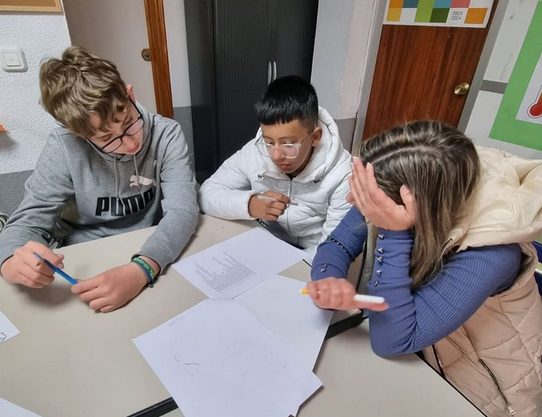

Slide 3


Slide 4
Volunteers and Educative Management for NGOs
Business Statement

Slide 5






Competitors
 | Free | Straightforward | Technical support | Volunteer, partners, donations management

Slide 6
Legal Impact
Data Protection Law
Data Security
RGPD (UE) + LOPDGDD (Spain)
Access control
Action Plan
Confidentiality and Privacy
Legal Responsibility
Clear politics and procedures

Slide 7



Development Agreement
Developer & Client
Client Responsibilities
Deadlines
Date | Activity
25/03/24 | Deliverable 1
30/03/24 | Feedback 1
15/04/24 | Deliverable 2
23/04/24 | Feedback 2

Slide 8


Customer Agreement
Service Provider
Privacy
Intellectual Property
Liability

Slide 9
TCO
3.000 €/month
Development + Contingency + Production
150.000 €
98 weeks

Slide 10



GitHub Actions
Codacy Security Scan
Format code with Black
7 €/month

Slide 11
CAPEX/OPEX
55.000 €
Material + Equipment Amortization + Initial Licenses
90.000 €
Salaries + Licenses + Maintenance + Production + Marketing

Slide 12
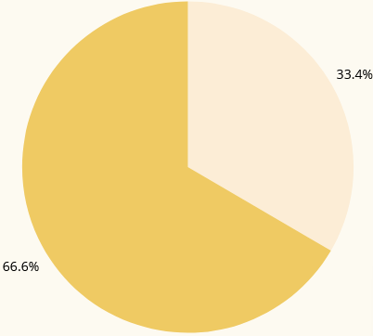
Money Spent (up to Monday 4th 18:00)
66% (25.000€)
Money Spent
34% (12.600€)
Money Left

Slide 13
Money Income
Target group = 900 similar NGOs
Estimation | Nº NGOs of the 540 | Expenses | Benefits/month | Time needed
Positive | 378 (50%) | 200.000 € | 40.000 € | 1’5 months + hire 60
Realist | 189 (20%) | 100.000 € | 20.000 € | 2’5 months + hire 22
Pessimistic | 63 (10%) | 36.000 € | 7.000 € | 7 months

Slide 14
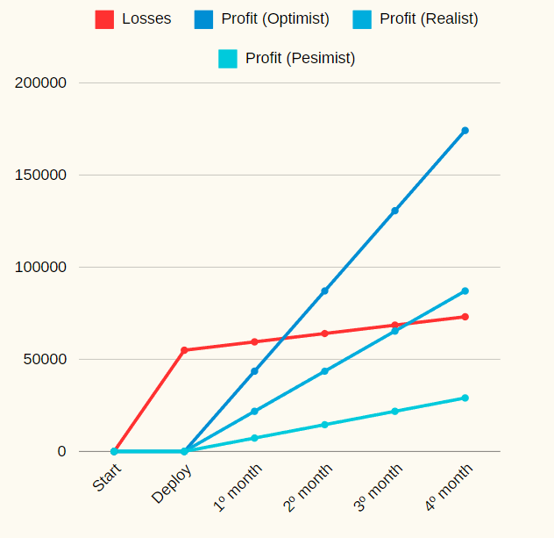

Slide 15
Our team (RACI Matrix)
 | PM | Team Leader | Junior Develop. | Secretary | Community Manager | Doc. Assignee | Reviewer
NGOs | A | I | I | I | R | I | I
Common DB | A | I | I | R |  | I | I
Solution Design | A | I | R |  | I | I
Docs | A |  | I |  | I | R | I
Software | A | A | R |  | I | I
Review the work done | R | R | C |  |  | C | R
Tests | A | A | R

Slide 16
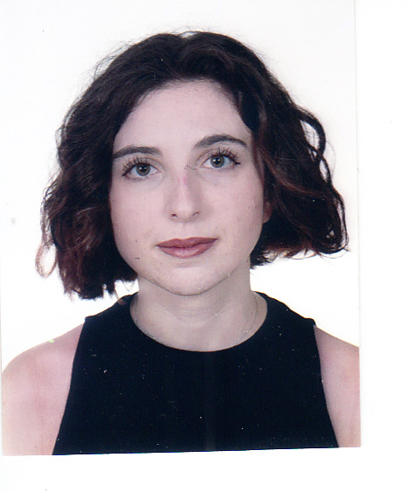
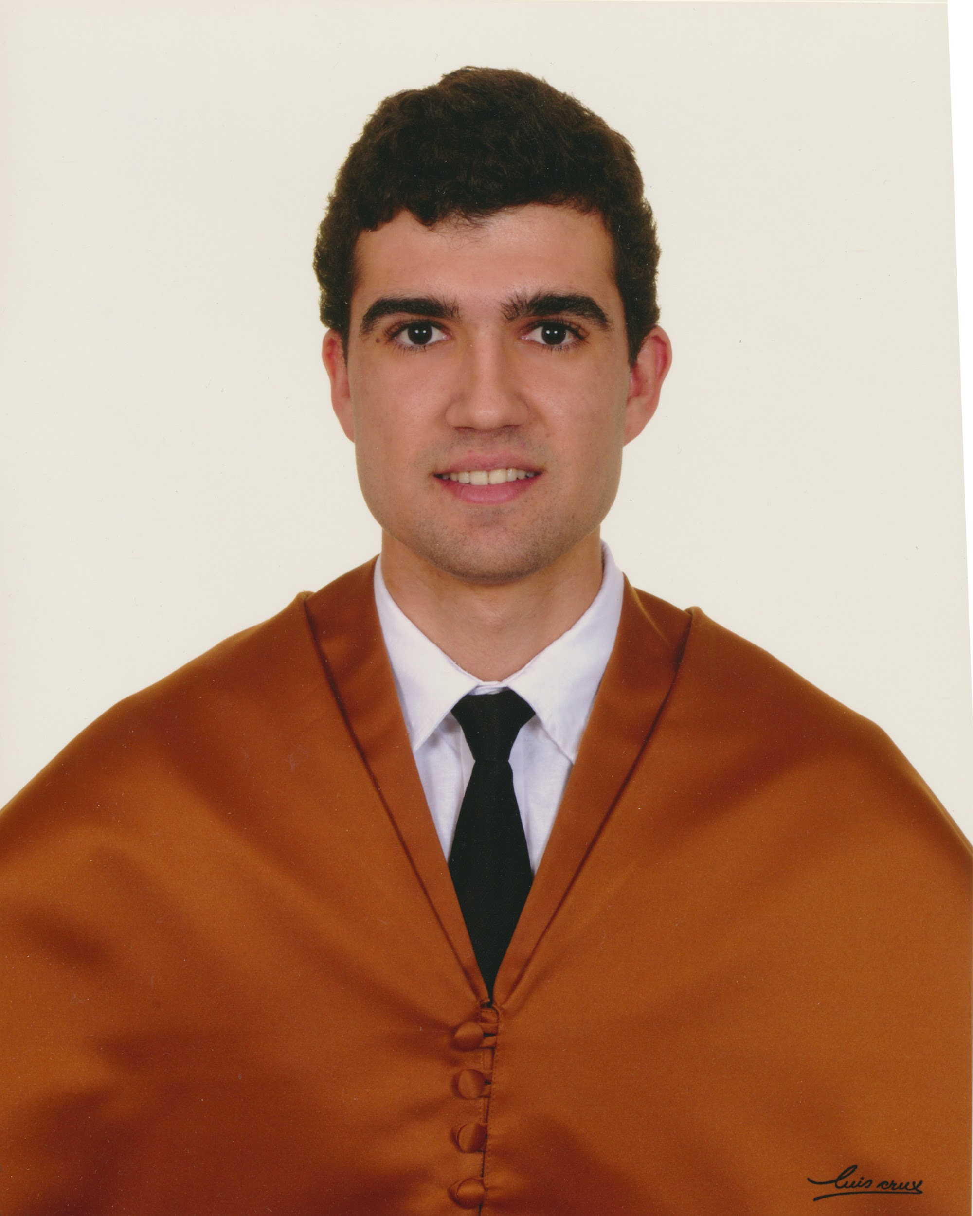
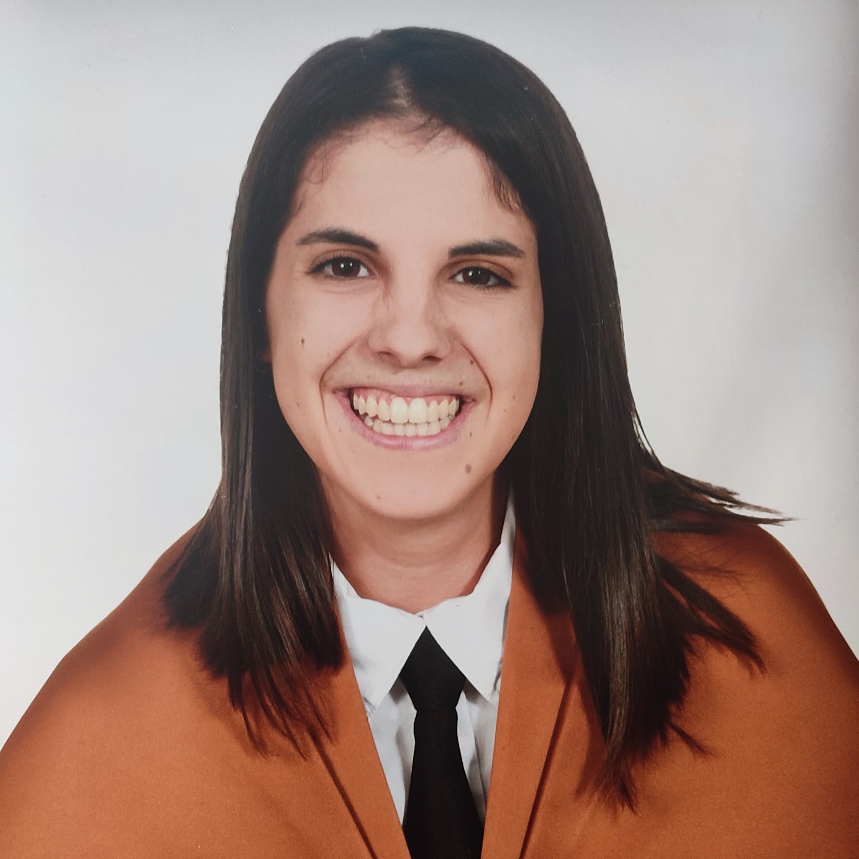
Our team
Marta González
Pablo Periañez
Claudia Gilabert
Project Manager
Back End Team Lead
Front End Team Lead
Speaker

Slide 17
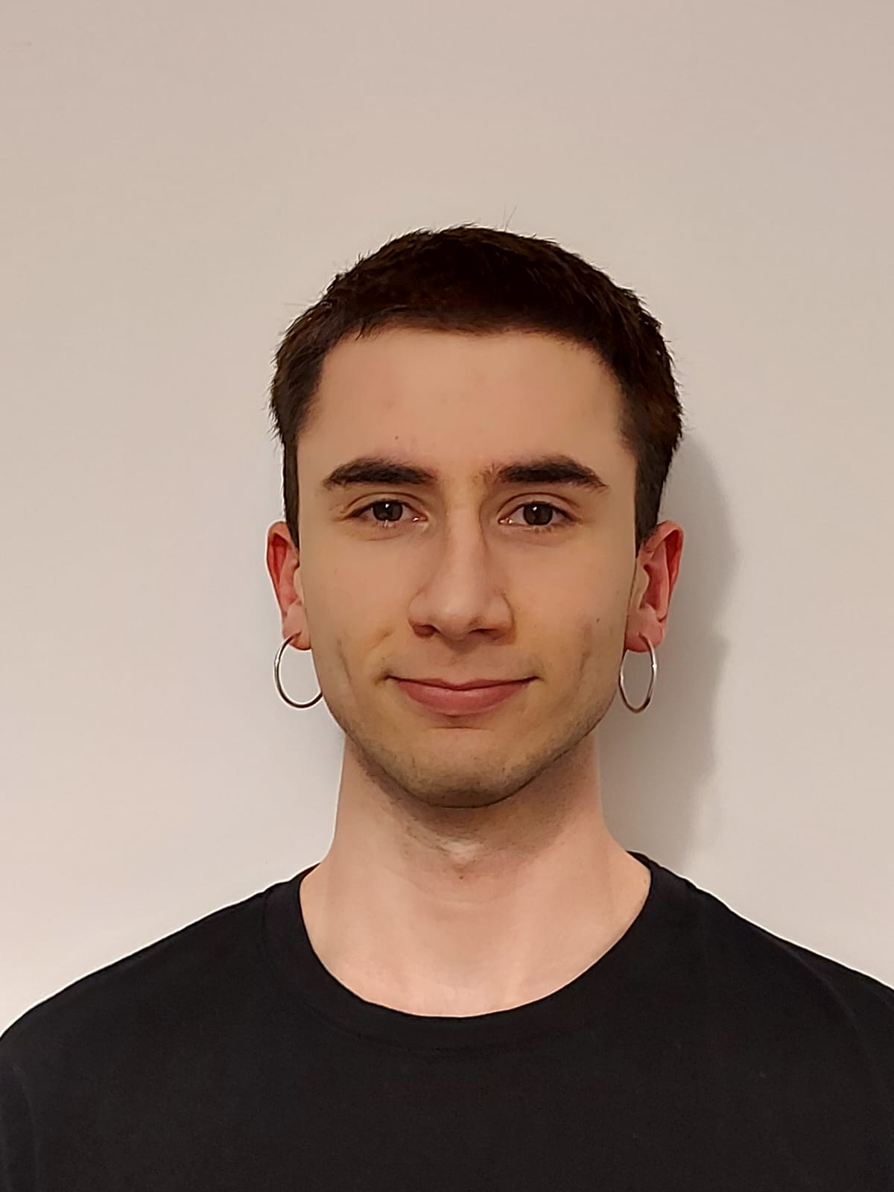
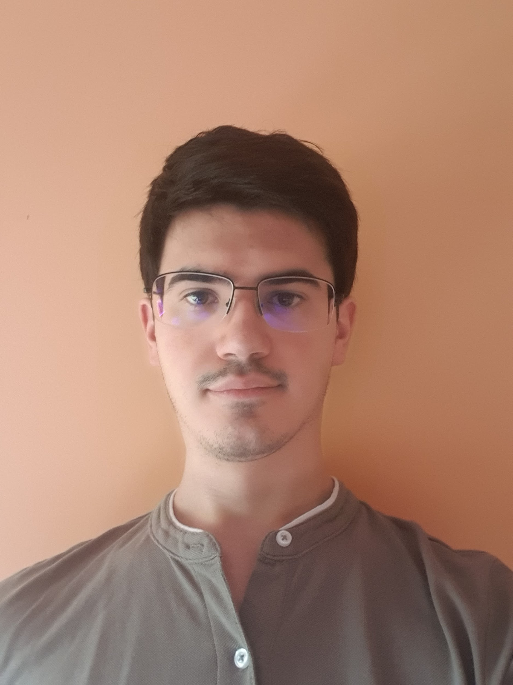
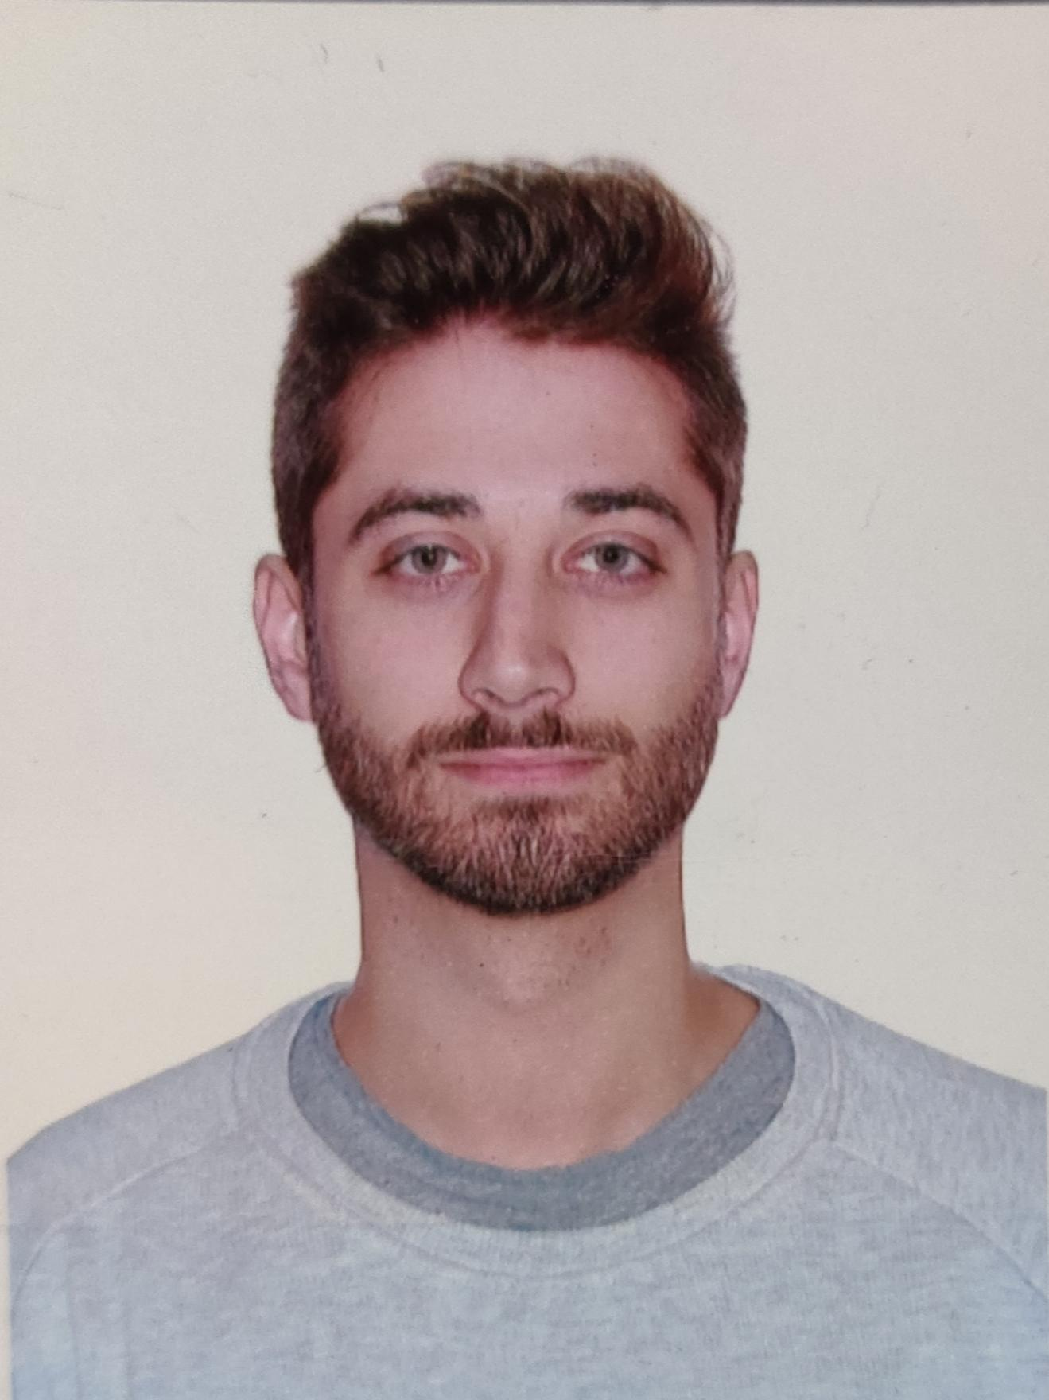
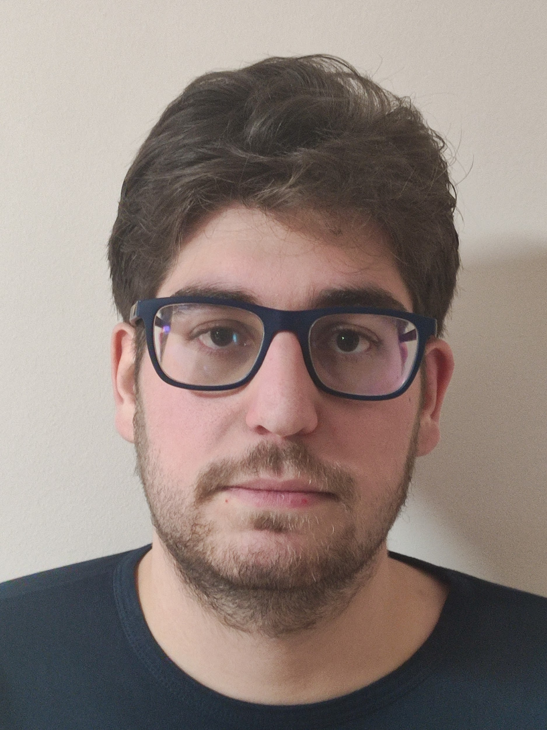
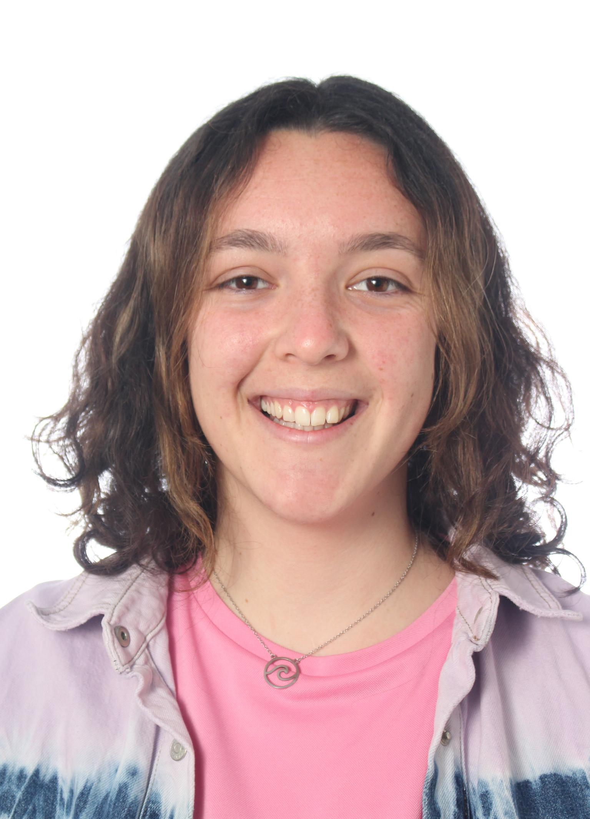
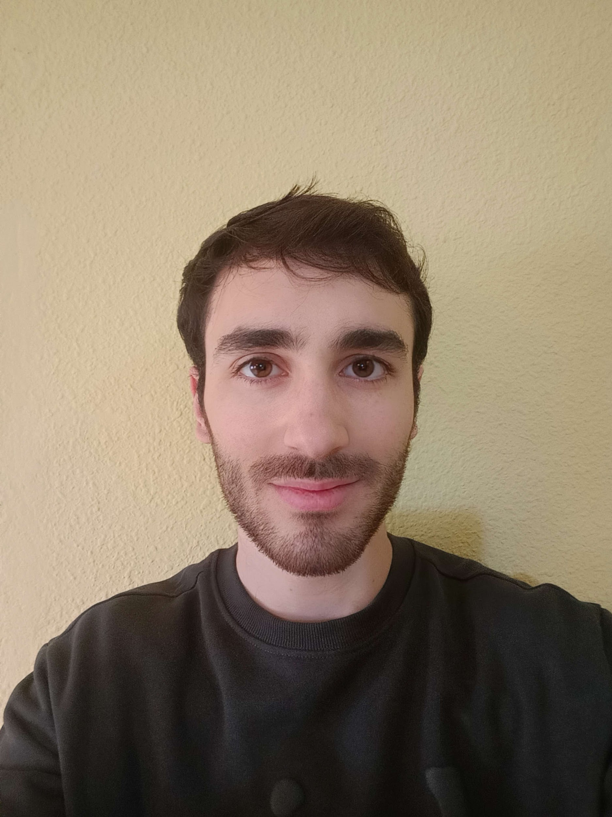
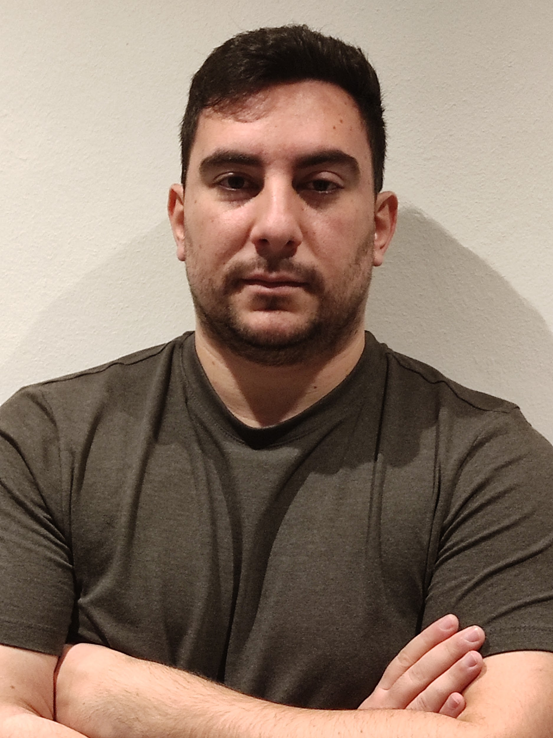
Our team (Back End Programmers)
Felix Gudiel
Juan Luis Ruano
Manuel Ortiz
Pedro López
Aurora Navas
Sergio Aguayo
Community Manager
Secretary
Miguel Ángel Romalde

Slide 18
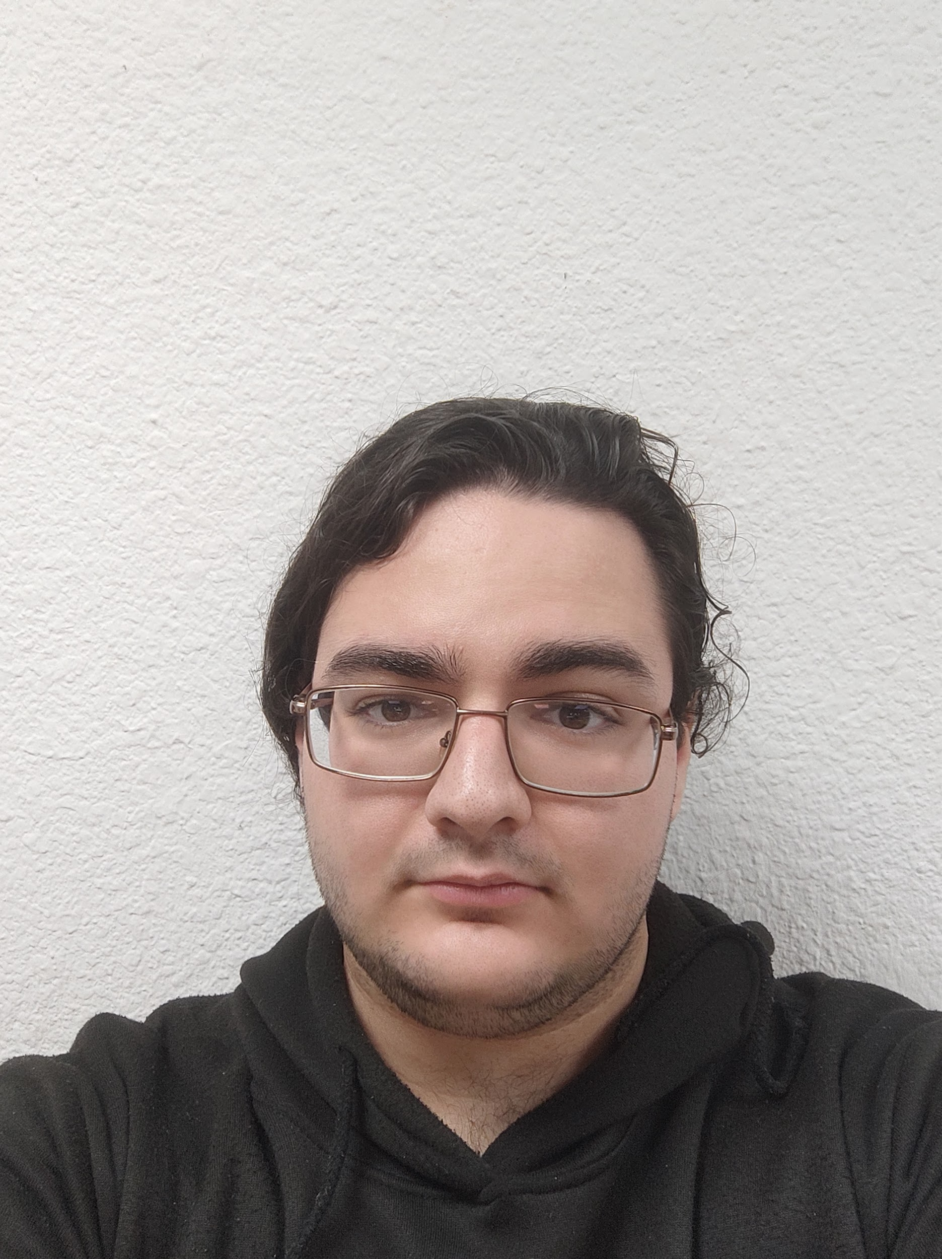
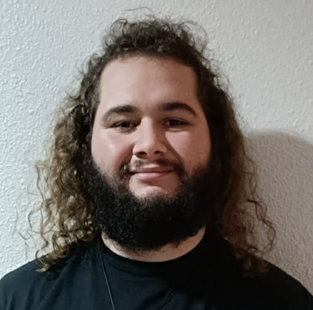
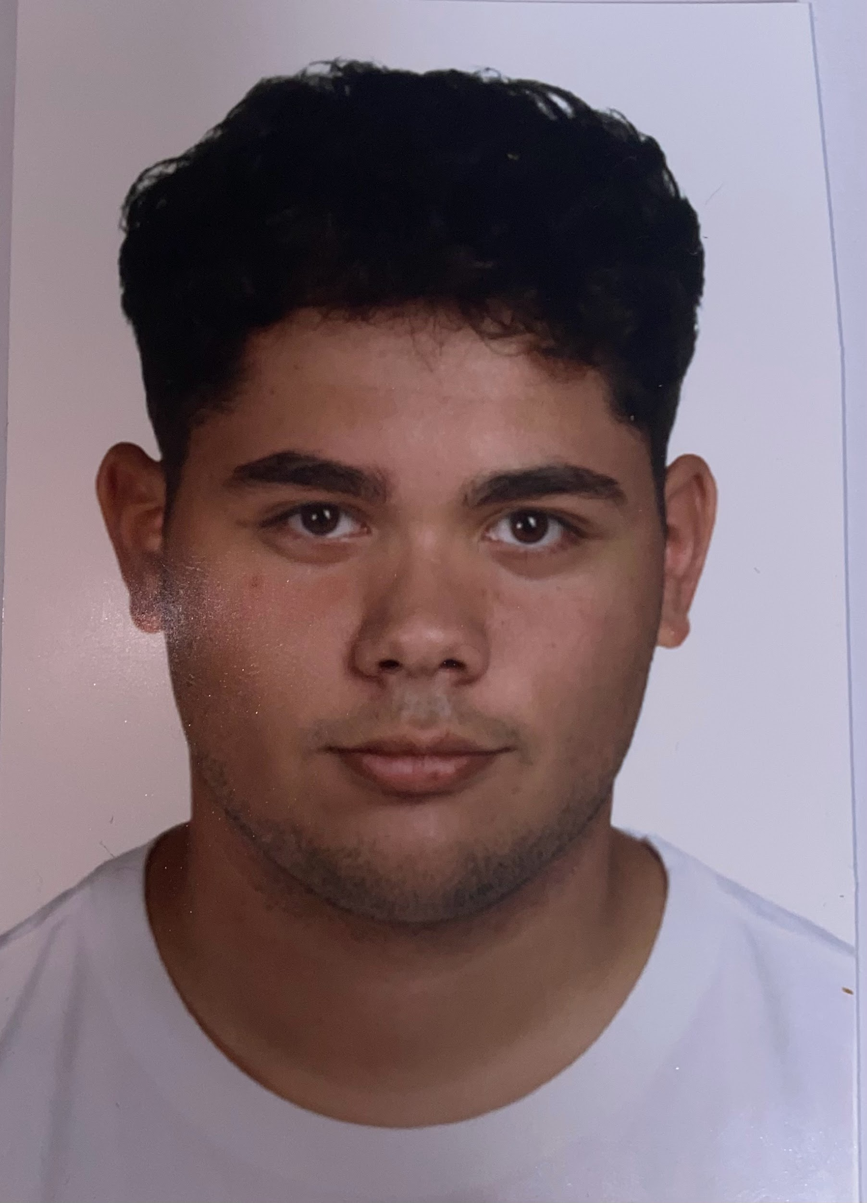
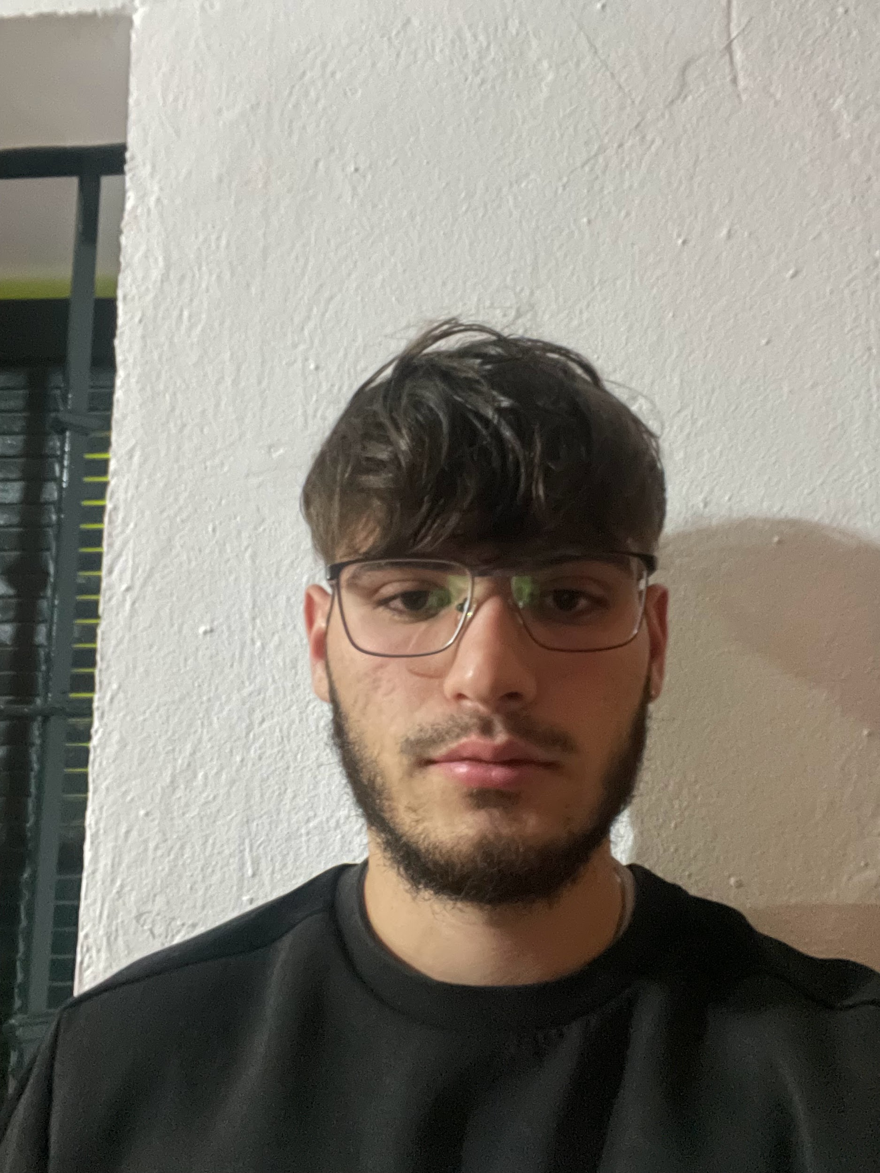
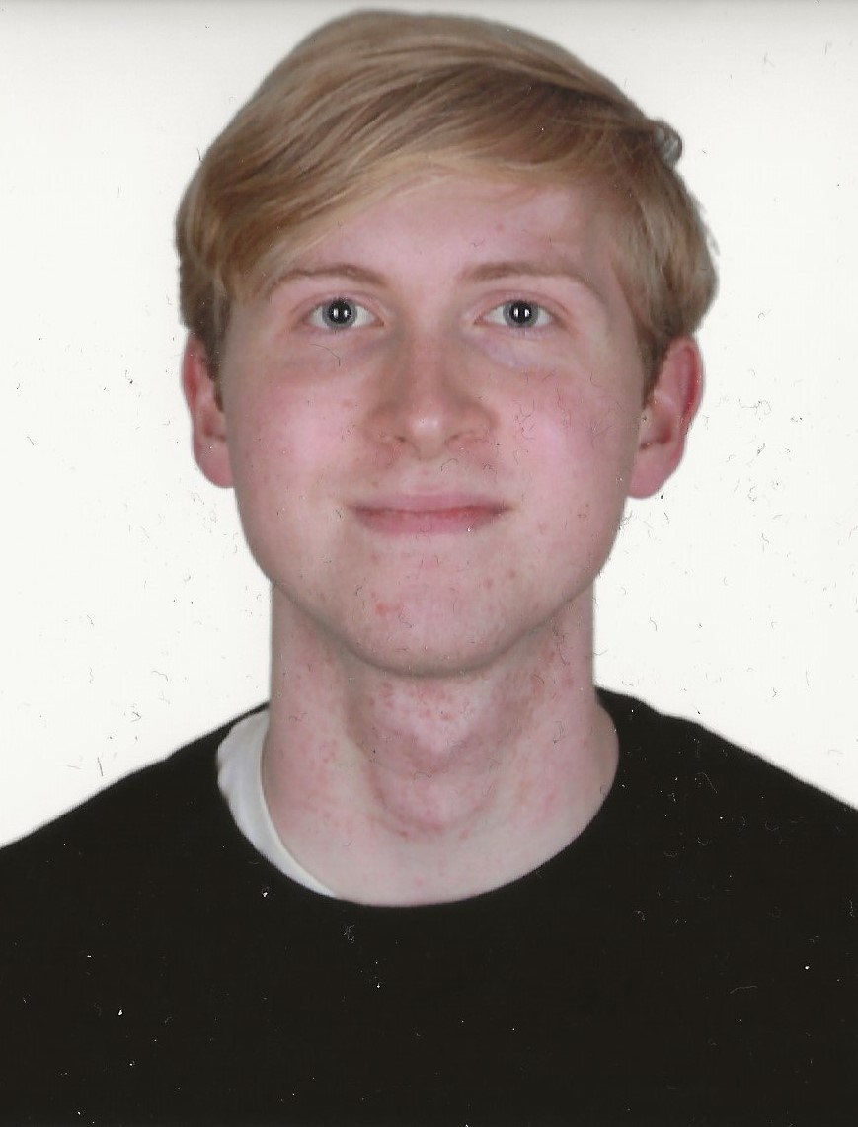
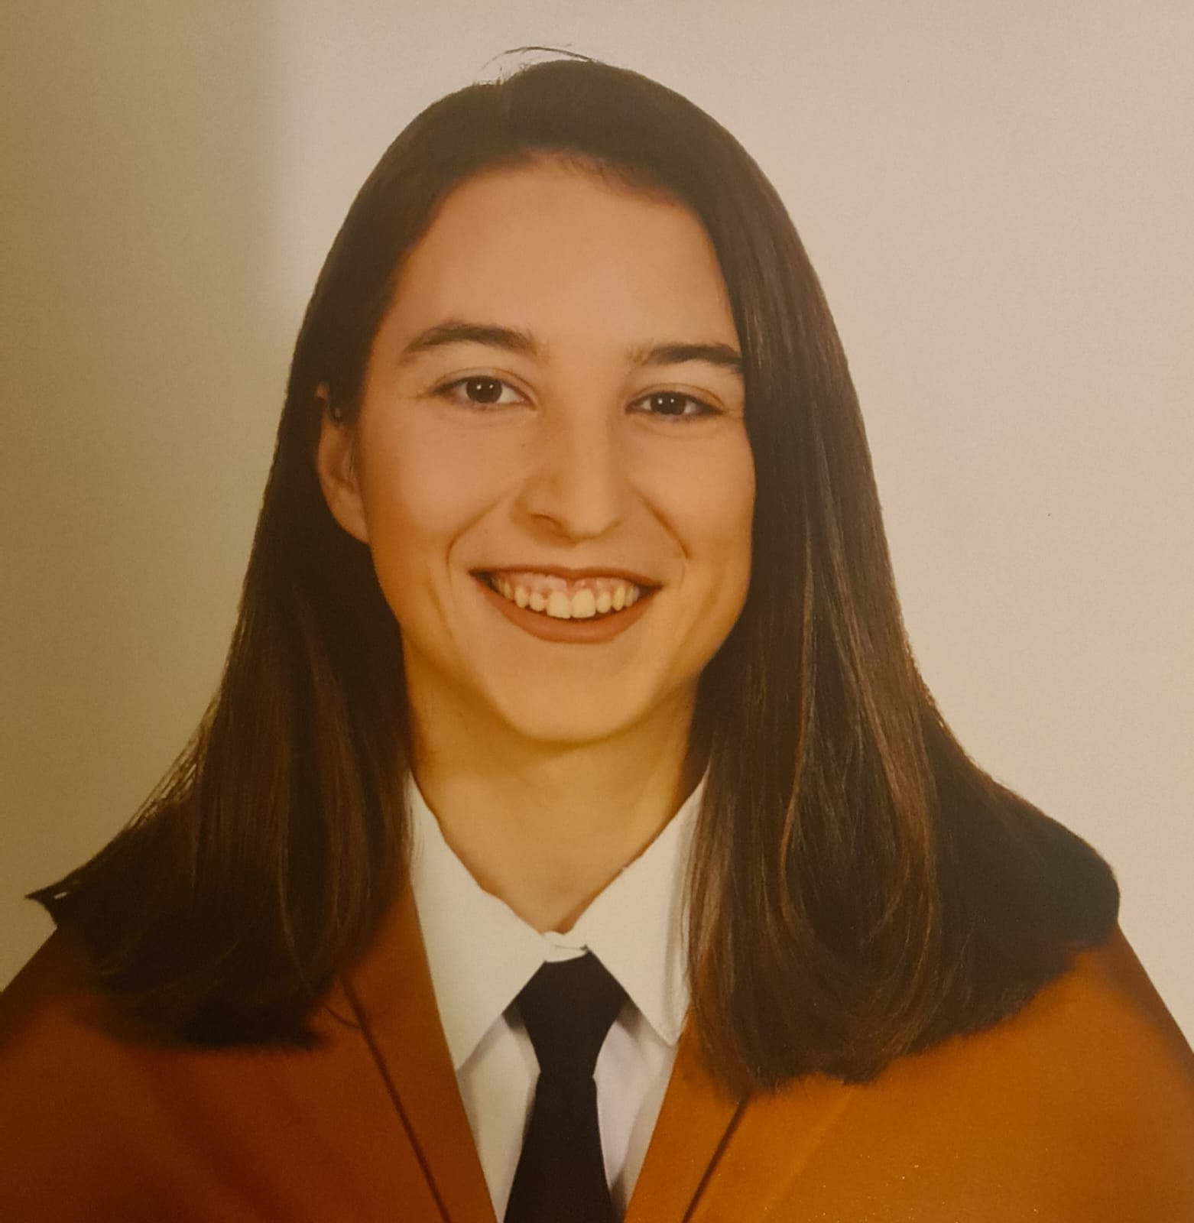
Our team (Front End Programmers)
Francisco Calderón
Francisco Rosso
Manuel Barcia
Iván Ramírez
Samuel Rodríguez
María Nuñez
Community Manager

Slide 19
Commitment agreement
Time Dedication
93 %
Rewards
Weekly Effort
100 %
Review
Deadlines
75 %
Disagreements
Strikes
Democracy
Clockify
Evaluation
Appendix

Slide 20
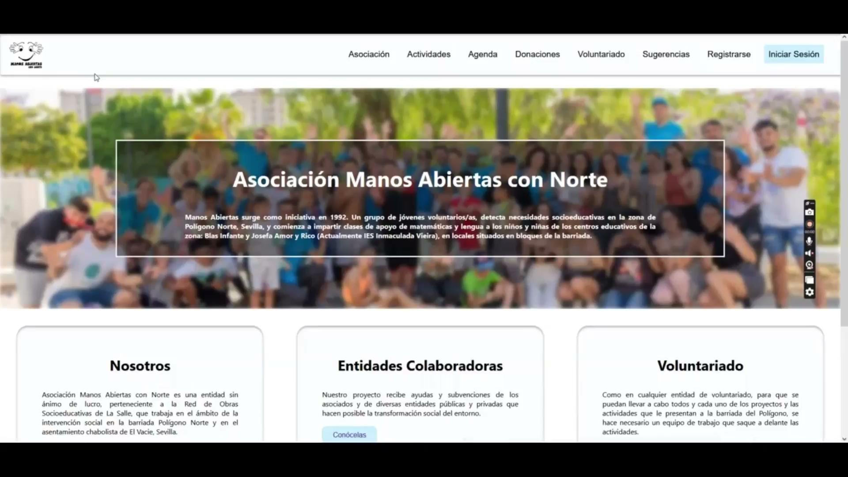

Slide 21

Retrospective (23.03)
Went Well (9) | To Improve (5) | Actions (3)
Documentation tasks assigned the first day | Research on your own | Regular meeting between TLs
Good working environment | Changes in the requirements
Teamwork | Communication between back and front TL | TL must talk with people to know their availability
PRs’ feedback

Slide 22
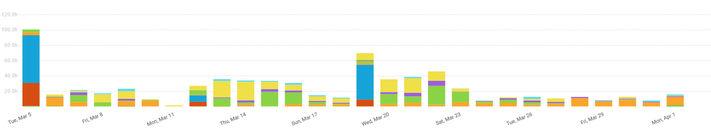
Team Performance (up to 18th 12:08)
Docs
Backend
Lectures
Meetings
Frontend
Theory Pills
Reviews

Slide 23
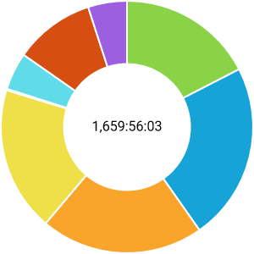
Team Performance (up to 4th 21:45)
Lectures (22%)
Theory Pills (5%)
Meetings (10%)
Docs (20%)
Backend (17%)
Frontend (18%)
Reviews (5%)

Slide 24
Time Spent (up to Monday 4th 18:00)
66% (1.598 hours)
Time Spent
34% (802 hours)
Time Left

Slide 25
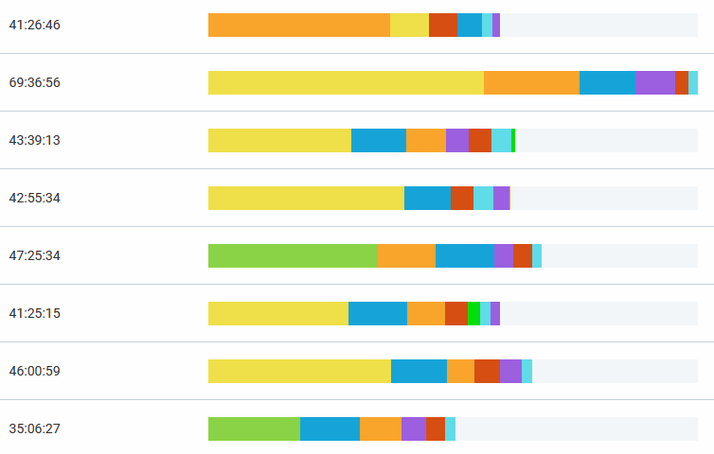
Individual Performance
Lectures
Theory Pills
Meetings
Docs
Backend
Frontend
Reviews

Slide 26
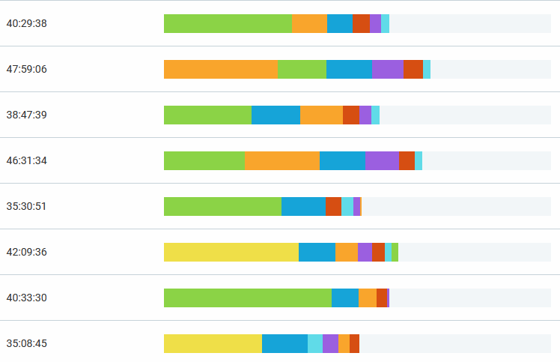
Individual Performance
Lectures
Theory Pills
Meetings
Docs
Backend
Frontend
Reviews

Slide 27


Individual Performance (Evaluation)
 | 1 | 2 | 3 | 4 | 5 | 6 | 7 | 8 | 9 | 10 | 11 | 12 | 13 | 14 | 15 | 16
DP | 9,5 | 9,8 | 8,8 | 7 | 9,4 | 8,9 | 8,8 | 9,3 | 8 | 10 | 10 | 9,1 | 10 | 9,3 | 9,3 | 9,7
S1 | 9,7 | 9 | 9,5 | 8,1 | 8 | 7,3 | 9,3 | 9,2 | 8,9 | 9,3 | 10 | 7,9 | 9,8 | 9,2 | 9,2 | 9,5
S2 | 10 | 10 | 10 | 9,6 | 9,8 | 9,9 | 10 | 9,9 | 10 | 9,9 | 10 | 9,4 | 10 | 9,6 | 10 | 9
Variance

Slide 28
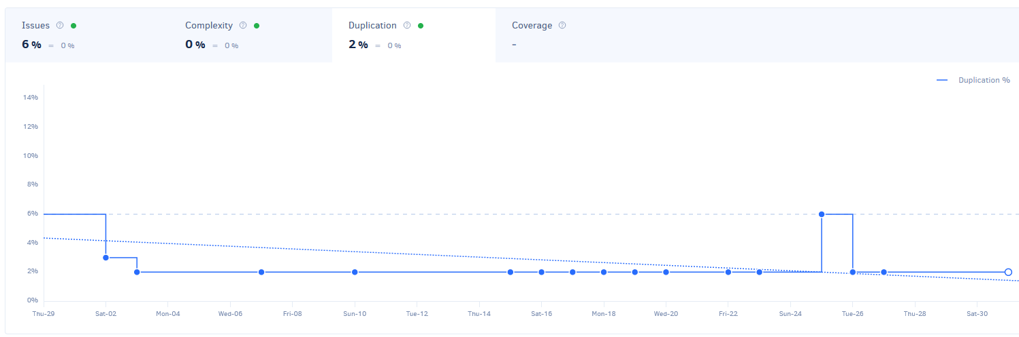
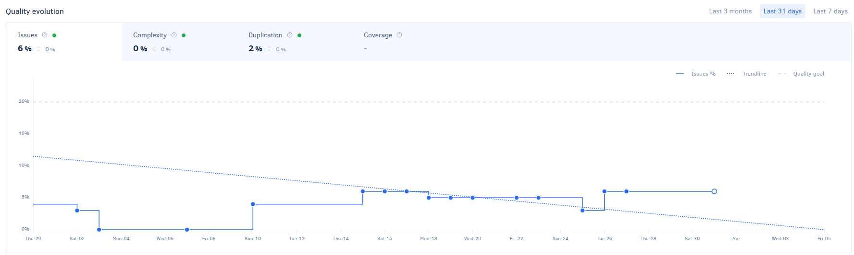
ALM (Backend)

Slide 29
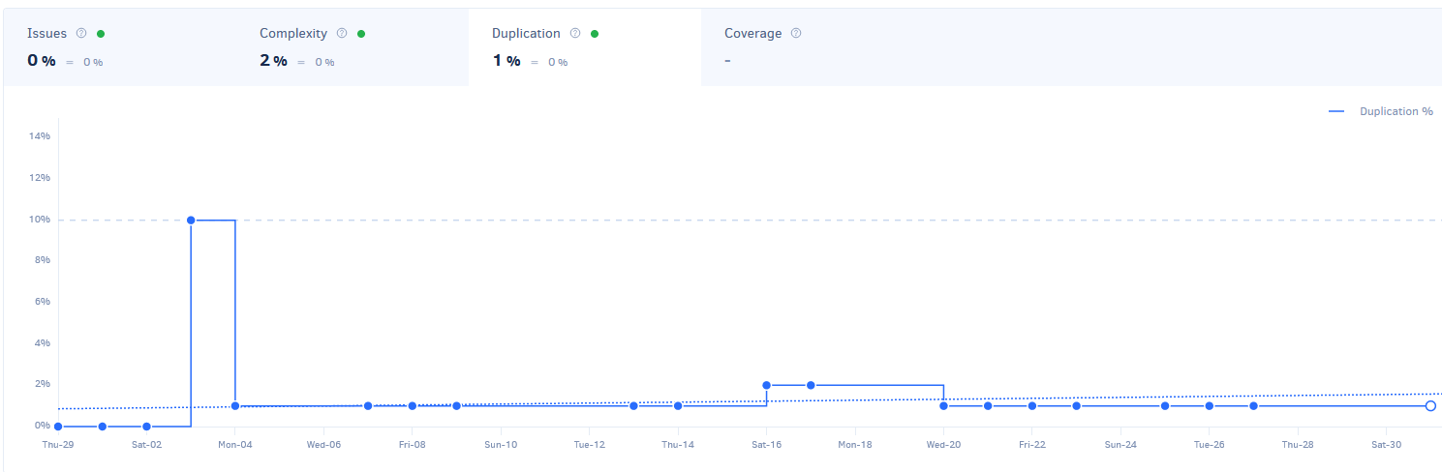
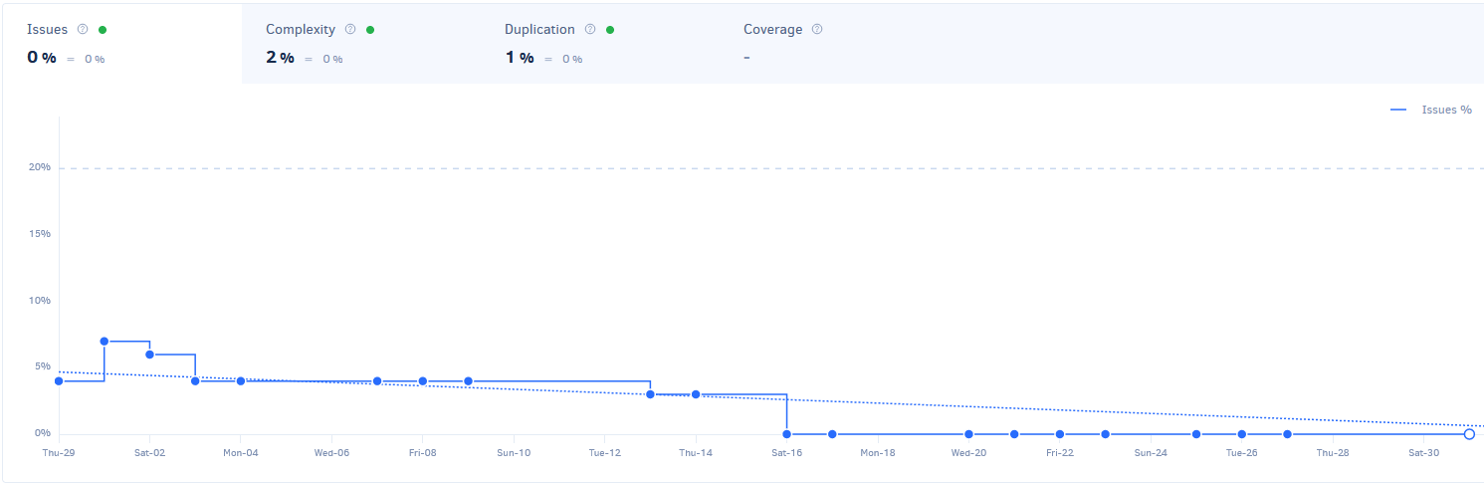
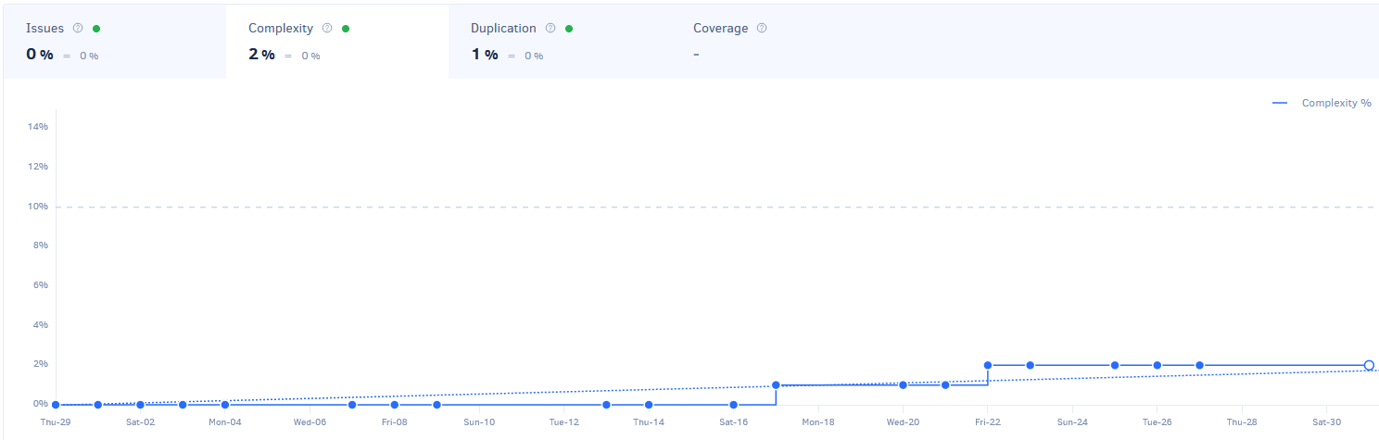
ALM (Frontend)

Slide 30
Risk analysis
External
Internal-external
Internal
Slow Response
Member resignation
Misunderstandings
Changes
<c
Technical
Estimation
Organizational
Hardware Failure
Exceed budget
Low Productivity
<c
<c
<c
Getting stuck on a task
Milestones delay
<c
<c
Optimistic planning
<c

Slide 31
Risks Encountered
PM
Team Leader
Junior Developer
 | Rare | Not likely | Possible | Likely | Very likely
Catastrophic
Big |  | Slow Response (R1)
Moderate
Small
Insignificant

Slide 32






Problems and Solutions
01
02
03
04
Problematic
Merge
TL
Communication
Refusal to do
some tasks
Commitment Agreement
Breach

Slide 33
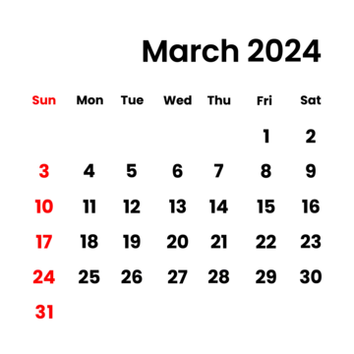
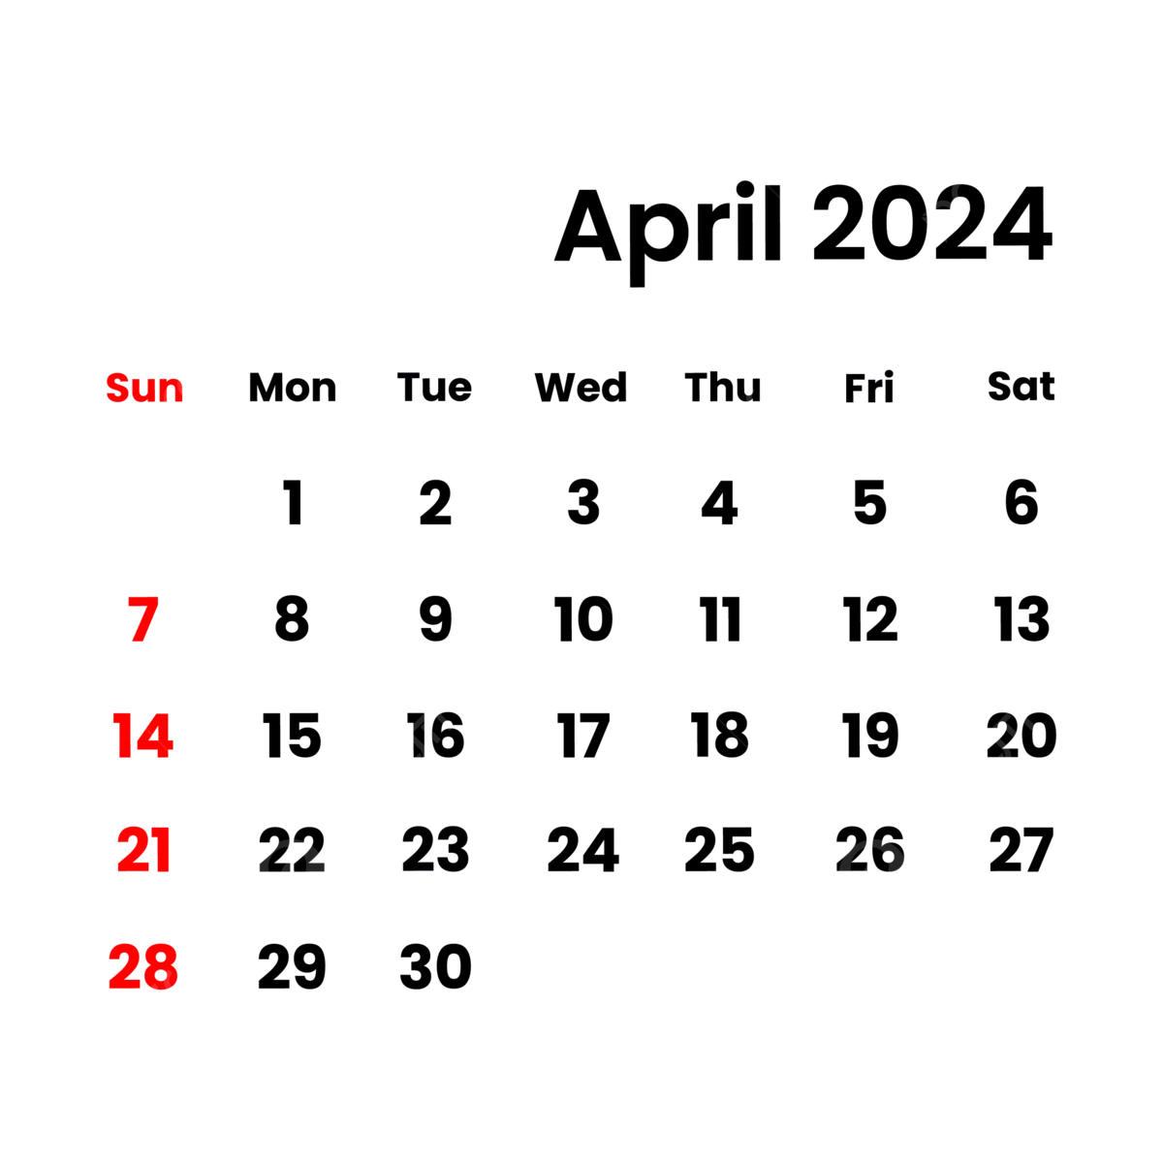
Feedback G11
Pilot Users
Delivery
Feedback
1
1
14
17
22
25
27

Slide 34

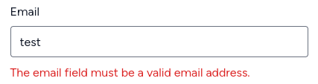

01
02
03
04
05
Pilot Users Feedback (G11)
Responsiveness
Validations
Style
Specific error messages
Performance

Slide 35




Commitment agreement
Shared Interests
Responsibilities Scoop
Deadlines
Confidentiality
Disagreements and Communication

Slide 36
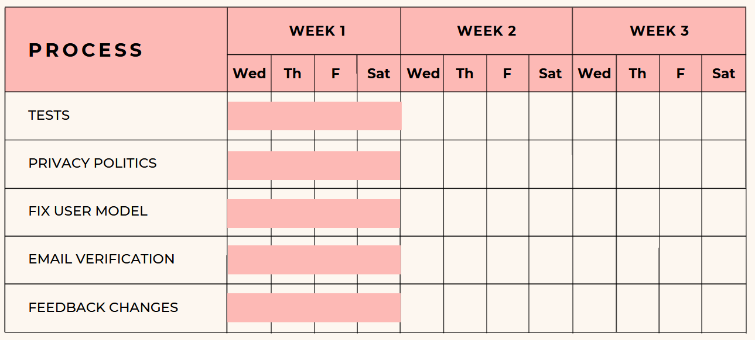
Sprint 3 (Backend)

Slide 37
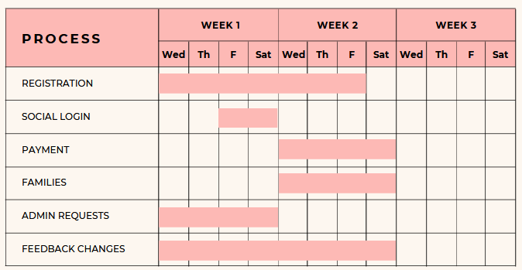
Sprint 3 (Frontend)

Slide 38




AI Usage (Sprint 2)
5 people
3 times
+
5 times

Slide 39


Commitment Agreement
Killer Opener
Demo
Competitors
Retrospective
Advertisement
Performance
Legal Impact
ALM
Development Agreement
Risks
Customer Agreement
Problems and Solutions
TCO
Pilot Users Status
GitHub Actions
Pilot Users Feedback
Money Spent
Commitment Agreement Users
Money Income
Sprint 3
Our Team
AIs Usage

Slide 40


Thanks for your time
In case you want to contact us:
margondia22@alum.us.es

